Slide 1
EDNY ADR Department
Columbia Law School
Ethics Colloquium
Antiracism and the Mediator’s Role: Irreconcilable Differences or Ethical Imperative?
November 13, 2020

Slide 2
Welcome and Introductions
Professor Alexandra B. Carter Director, Columbia Law School Mediation Clinic
Jeeyoon Chung, Meyer Horne, Young Joon Joo, Oliver Kwon,
Cam Molis, Mie Morikubo, Matthew Robinson, Cory Steinberg, Erica Zou
Notes:
Prof. Carter

Slide 3
Goals for This Workshop
Identify the ways in which race and racial bias manifest in a mediation context
Examine the role of the mediator in navigating issues of race and racial bias throughout the mediation process
Discuss best practices for ethical dilemmas that arise when mediating situations where racial tensions, dynamics, and factors may emerge
Notes:
Prof. Carter

Slide 4
Conversation Starter
During a mediation process, have you ever come across a situation where you felt that racial tension, dynamics, or biases have played an underlying role in driving party behavior, or even potential outcomes? If so, what did you notice?
Notes:
[Matthew and Erica]

Slide 5
What is Antiracism
Intro: three levels of cultural/racial awareness and training are needed to effectuate positive change
Diversity Awareness
Cultural Competence
Antiracism
Do they address:
Individual Racism?
Interpersonal Racism?
Institutional Racism?
Systemic Racism?
Notes:
These three levels of awareness/understanding are all crucial to building more positive, inclusive, and just environments, BUT they are not the same in the issues they address and in the depth of their impact.

Slide 6
What is Antiracism?
DIVERSITY AWARENESS
Pros | Cons
Acknowledges and respects differences | Only focuses on racism on an individual or interpersonal level
Celebrates learning about a variety of cultures | Presents diversity/cultural awareness as a corporate or organizational asset
Develops sensitivity and understanding toward different ethnic groups | Does not address institutional racism, systemic racism, or social dynamics
Notes:
[Erica]
Diversity training presents an important and potentially influential initiative. However, diversity training often demonstrates an incomplete approach to race-related training, as it emphasizes raising awareness and often omits discussions around systemic racism and social dynamics.
The conversations that occur during diversity training explore the people included and excluded in an organization or opportunities, why an organization should be inclusive, and whether the organization commits to evolving its practices. When implemented as the first step in a larger race training process, diversity training offers a space for reflection on participants’ beliefs and an organization’s opportunities.
Best practices literature for corporate diversity training notes that “the primary goal [of diversity training] is to create ongoing awareness and understanding of human diversity as a corporate asset.”
http://www.wasa-oly.org/WASA/images/WASA/6.0%20Resources/Equity/From%20Culturally%20Competent%20to%20Anti-Racist---Types%20and%20Impacts%20of%20Race-Related%20Trainings.pdf

Slide 7
What is Antiracism?
CULTURAL COMPETENCE
Pros | Cons
Goes beyond mere awareness and pushes the ongoing practice of cross-cultural learning | Does not address issues of power, privilege, or access through a critical lens - does not address systemic racism
Moves from acknowledgment of diversity to active celebration of diversity | Maintains predetermined assumptions about cultural beliefs/characteristics and creates a sense of “otherness”
Notes:
Cultural competency training informs participants about different cultures’ values and distinctions to facilitate interactions with individuals that identify with another culture. Proponents of cultural competency note that this type of training goes beyond awareness and presents an ongoing practice that requires people to learn cultural developments and gain skills for various interactions.Additionally, the concept of cultural competency stems from cultural diversity (i.e., “the differences between people based on a shared ideology and valued set of beliefs, norms, customs, and meanings evidenced in a way of life”), and reflects the act of understanding cultural differences and using them to better engage with others.
Critics find that cultural competency training lacks a critical lens, maintains a set understanding of a culture’s beliefs and characteristics, and often creates a sense of “otherness” among non-white groups. Although the training aims to support participants in interacting with a variety of people and reducing inequities, the approach may be too general and potentially harmful through its ability to create outgroups. A critique of cultural competency finds that this training does not confront power dynamics and considers the topic a new form of racism that sustains oppression and “involves a shift away from racial exclusionary practices based on biology to practices based on culture.”
http://www.wasa-oly.org/WASA/images/WASA/6.0%20Resources/Equity/From%20Culturally%20Competent%20to%20Anti-Racist---Types%20and%20Impacts%20of%20Race-Related%20Trainings.pdf

Slide 8
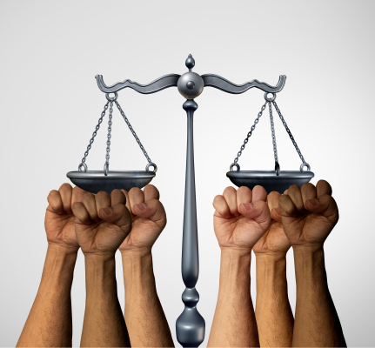
What is Antiracism?
ANTIRACISM
Understands that inequality exists not just on the individual, but also the systemic and structural level
Evaluates issues of unequal power and access from a broader societal perspective
Addresses how existing practices, policies, and procedures under-serve People of Color and over-serve White People
Notes:
[Erica]
Graphic: https://www.lclma.org/2020/07/31/how-to-be-an-effective-antiracism-ally-in-the-legal-profession-resources-bba-program-notes/

Slide 9
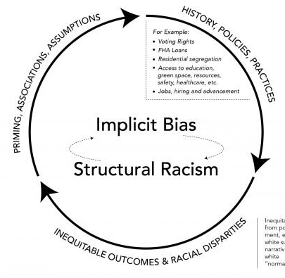
What is Antiracism?
“Implicit Bias and Structural Racialization,”
By Kathleen Osta & Hugh Vasquez, National Equity Project.
Notes:
https://www.nationalequityproject.org/frameworks/implicit-bias-structural-racialization

Slide 10
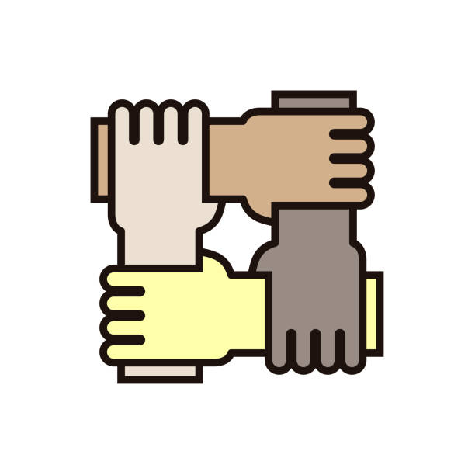
What is Antiracism?
Antiracism is “the active process of identifying and eliminating racism by changing systems, organizational structures, policies and practices and attitudes, so that power is redistributed and shared equitably."
“THE OPPOSITE OF ‘RACIST’ ISN’T ‘NOT RACIST.’ IT IS ‘ANTIRACIST.’”
Notes:
[Oliver]
http://www.aclrc.com/antiracism-defined
Quote reference: Ibram X. Kendi “How to Be an Antiracist”

Slide 11
Antiracism in Mediation
What is antiracism in the context of mediation, and why should we care?
Actively identifying issues such as bias and barriers in order to protect the integrity of the mediation process
Promoting awareness so mediators can recognize and address issues more effectively
Notes:
[Oliver]

Slide 12
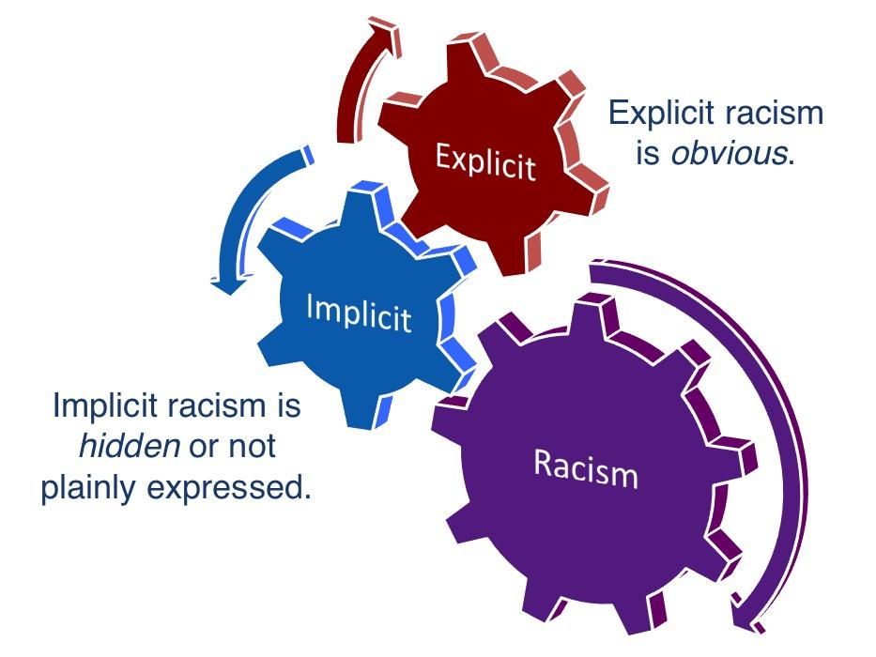
Manifestations in the Mediation Room
Overt Assertions of Racial Bias
Intentional or obvious harmful attitudes or behaviors towards a party because of their race or racial background.*
Overt racial bias can manifest in direct prejudice, hostility, or clear negative feelings.
Examples
Speeches or behaviors that demonstrate negative racial attitudes (i.e. racial slurs)
Use of generalized negative attitudes/stereotypes directed toward groups
“Overt Racism,” Fitchburg State University
Notes:
[Matthew]
https://fitchburgstate.libguides.com/c.php?g=1046516&p=7619360

Slide 13
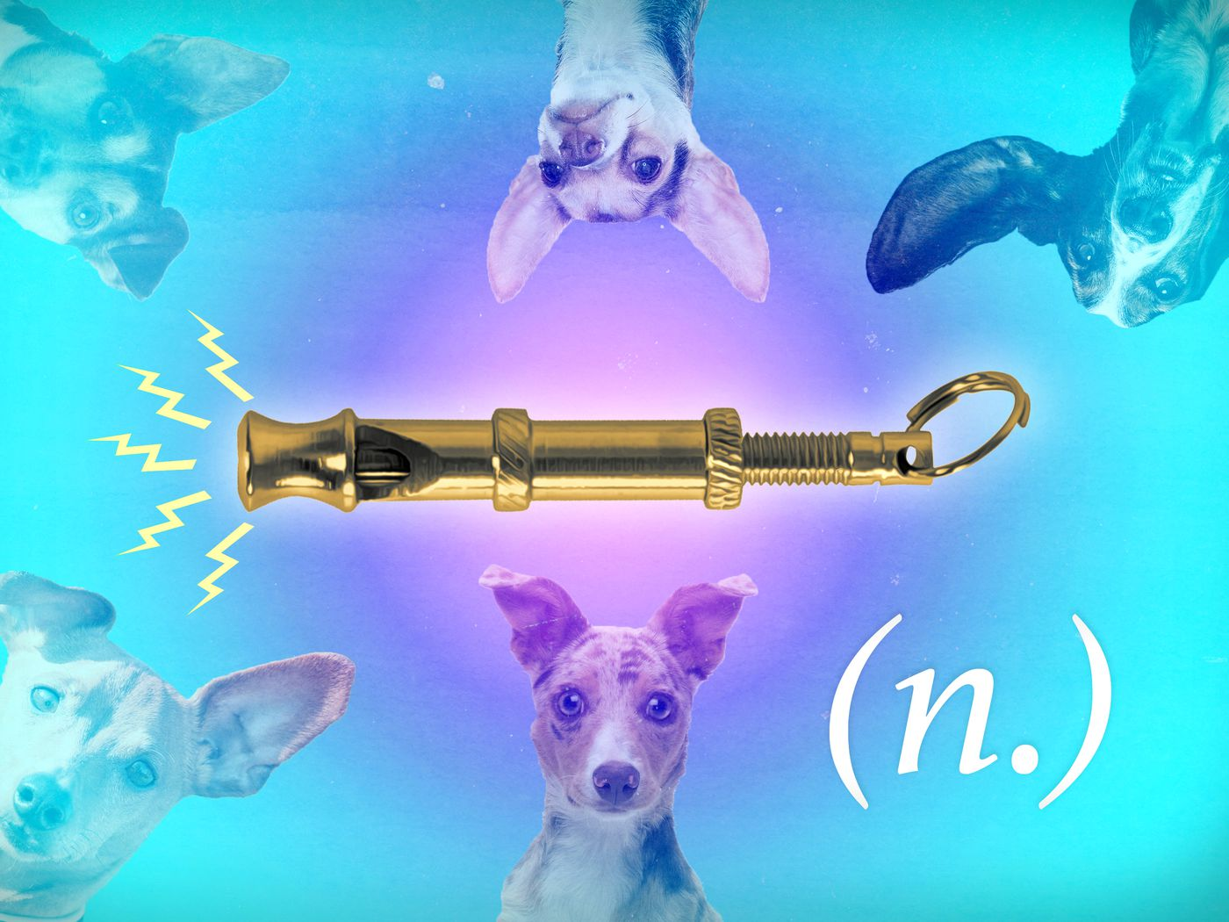
Manifestations in the Mediation Room
The Dog-Whistle Context
An expression, statement, or coded rhetoric that has a secondary meaning understood by a specific group.*
Active: An expression or statement intended to communicate a secondary meaning to a specific group.
Passive: An expression or statement that carries an unintended secondary meaning.
*Merriam Webster, Stephen Whitley, "Dog-whistle" rhetoric: Pedagogy and the coded language of modern american politics “ (2014).
Notes:
[Matthew]

Slide 14
Manifestations in the Mediation Room
Institutional skepticism
People of Color may have a lack of confidence in certain institutions (i.e. ADR system)
Very few neutrals at top ADR providers are of color
General lack of confidence in the legal system because of historical mistreatment
Over sentencing
Disrespect in the courtroom
Overrepresentation + underrepresentation
Lack of confidence could impact a party’s level of comfort in a mediation and how they would perceive intentions
Notes:
[Meyer]

Slide 15
Manifestations in the Mediation Room
Barriers to Communication
Racism, racial bias, and racial tensions can be the source of the interpersonal issues that initially place parties in mediation:
One’s racial background can cause continual barriers to communication - in group situations, racial dynamics can inhibit the sharing of a common vision
Olson et al., Language and Race: Barriers to Communicating a Vision
Notes:
[Young]

Slide 16
Manifestations in the Mediation Room
Barriers to Communication
Racism, racial bias, and racial dynamics can hinder communication and understanding between parties:
Unaddressed misconceptions, misunderstandings, or issues based around race may foster continual isolation from the issues and realities of POCs
Language and words that focus on “labels” (rather than “descriptions”) can oversimplify parties at best, and insult parties at worst
Notes:
[Young]

Slide 17
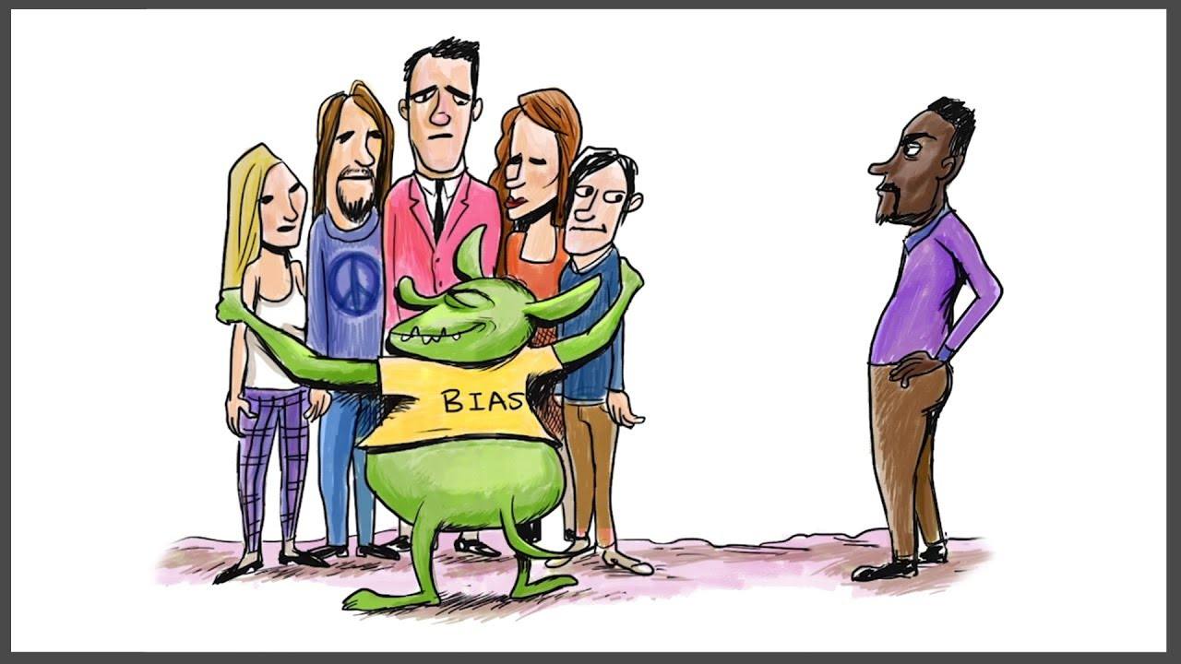
Manifestations in the Mediation Room
Potential Mediator Bias: The Issue of Implicit Bias
“Unconsciously held attitudes and stereotypes can affect our interaction with others and may predict behavior.”*
Often people do not have conscious and intentional control over social perceptions and judgments that motivate their actions.
After tens of thousands of Race IAT tests were taken, “88% of white people had a pro-white or anti-black implicit bias.”*
*Carol Izumi, Implicit Bias and the Illusion of Mediator Neutrality, 34 Wash. U. J. L.& POL'y 71 (2010).
*Shankar Vedantam, See No Bias, Wash. Po. (2005)
Notes:
[Matthew/Erica]

Slide 18
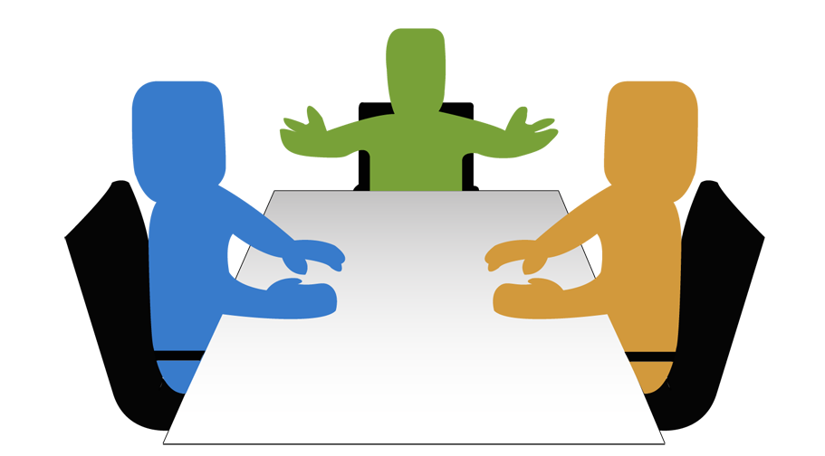
Color Blindness v. Color Consciousness:
A New Approach
Neutrality v. Impartiality
Neutrality
“A duty to refrain from supporting one party against another and imposing an opinion on the parties.”*
Impartiality
“Freedom from favoritism, bias or prejudice.”*
A mediator shall conduct a mediation in an impartial manner and avoid conduct that gives the appearance of partiality.
*Mercédeh Azeredo da Silveira, “Impartiality v. Substantive Neutrality: Is the Mediator Authorized to Provide Legal Advice?,” (2007).
*ABA Model Standards of Conduct for Mediators
Notes:
[Matthew]

Slide 19
Color Blindness v. Color Consciousness:
A New Approach
Colorblind Approach:
The belief that racial group membership and race-based differences should not be taken into account when decisions are made, impressions are formed, and behaviors are enacted.*
Color-Conscious Approach:
An approach that takes into account race-based differences when decisions are made, impressions are formed, and behaviors are enacted as a means of more directly addressing issues relating to racial inequities, biases, and discrimination.*
*Evan P. Apfelbaum, et al., “Racial Color Blindness: Emergence, Practice, and Implications,” (2012).
*Destiny Peery, “The Colorblind Ideal in a Race-Conscious Reality: The Case for a New Legal Ideal for Race Relations,” (2011).
Notes:
[Matthew]

Slide 20
Mediator Tools
Guaranteeing the Quality of the Process
The Mediator’s Responsibility:
A mediator shall conduct a mediation in ... a manner that promotes ... party participation, procedural fairness, ... and mutual respect among all participants.*
If a mediator believes that participant conduct, including that of the mediator, jeopardizes conducting a mediation consistent with these Standards, a mediator shall take appropriate steps including, if necessary, postponing, withdrawing from or terminating the mediation.*
Applying the Responsibility: Racism and implicit bias are incompatible with a fair and mutually respectful process.
*Source: ABA Model Standards of Conduct for Mediators
Notes:
Mediators are responsible for guaranteeing a fair & respectful process, and are tasked with addressing rather than neglecting deficiencies that arise (Standard VI A & C of the ABA Model Standards of Conduct for Mediators)

Slide 21
Mediator Tools
Guaranteeing the Quality of the Process
Regulating Mediator Biases:
A mediator must take appropriate steps to avoid allowing their own biases to impact a mediation.
Suggested Self-Assessment Question: Can I identify and pledge to combat my own biases that have the potential to influence the manner in which I conduct this mediation?

Slide 22
Mediator Tools
Guaranteeing the Quality of the Process
Regulating Party Biases:
Suggested Phrasing: “In order for me to feel like I am conducting a fair and inclusive mediation, we can’t use offensive and discriminatory terms to describe one another.”
Bottom Line: When a mediator disrupts racism in a mediation, they are not interceding on behalf of one of the parties but rather on behalf of the process itself.

Slide 23
Mediator Tools
Leaning into Caucus
“Caucuses permit the mediator and the parties to explore more fully the needs and interests underlying the stated positions.”*
Confidentiality and candor
Venting and de-escalation
Information gathering
Coaching and reality testing
Caution (consider impartiality, neutrality, bias, power)
*Source: Local Rules of the U.S. District Courts for the Southern and Eastern Districts of N.Y., Local Civil Rule 83.8.
Notes:
A caucus is a private session; a meeting between the mediator and one party to a mediation without the other party (or parties). It is an opportunity for the mediator
Confidentiality and candor: ABA model standards require that mediators respect the additional layer of confidentiality in private sessions. While this additional confidentiality can create some complications, it also creates an opportunity to solicit greater candor from each party. In particular, caucus may provide the opportunity to discuss racism directly in a way that may not be available in joint session.
Venting and deescalation: Racism and accusations of racism can elicit strong emotions. If needed, a caucus can provide a forum for parties to vent without further escalating high emotions as might happen in joint session. Giving parties space to vent those emotions separately and de-escalate may be productive if it allows parties to process their feelings (and eventually discuss or evaluate how they would like to proceed).
Information gathering: The confidentiality of caucus (and the ability to de-escalate high emotions) provide the opportunity for information gathering. In particular this may be helpful in considering how the process should continue to unfold in order to best respect each party’s self-determination and comfort.
Coaching and reality testing: Caucus may also provide the opportunity to reality test the use of dog-whistle language from the perspective of facilitating meaningful communication. Additionally, caucus may provide an opportunity to be more explicit about any mediator limits on language or conduct if there has been overt and intentional racism.
Caution: The common criticisms of caucus apply here and perhaps with extra force. Mediators need to be aware of their own biases, the effect caucus has on their impartiality or neutrality, how they might be affecting the power balance through caucus, and how the parties perceive the fairness of the caucus process.
Additional Sources:
Nancy Welsh, Do You Believe in Magic?: Self-Determination and Procedural Justice Meet Inequality in Court-Connected Mediation, 70 SMU L. Rev. 721 (2017).
Christopher W. Moore, The Caucus: Private Meetings That Promote Settlement, 1987 Mediation Q. 87.
Josefina M. Rendon, Under the Justice Radar: Prejudice in Mediation and Settlement Negotiations, 30 T. Marshall L. Rev. 347 (2005).

Slide 24
Mediator Tools
Acknowledgment/Stroking
Why?
Demonstrates mediator impartiality
Minimizes reactive devaluation
Highlights constructive behavior
Models empathy for participants
Notes:
[Jeeyoon]
Acknowledgment is when the mediator points out progress or a productive move by one party to make sure the other party notices and processes it. This can be anything from pulling out a reluctant acknowledgment by one party of the other’s feelings to an off-hand apology.
Stroking is when the mediator praises a party for any positive behavior. You could stroke a party’s civility, self-advocacy, or even just for bearing with the process.
So why choose these tools to promote anti-racism as a mediator?
First and foremost, when parties see that the mediator is acknowledging positive contributions and behaviors of both sides, it helps them see that the mediator is impartial. As ___ mentioned, this increases legitimacy and trust in both the process and the mediator and is all the more important to establish as groundwork for anti-racism.
If a party sees the counterparty as part of an “out-group,” they may feel threatened and, as I’m sure many of you have seen, this leads to a party who is more recalcitrant, defensive, or combative. In fact, in polarized contexts it’s quite common to see a party dismiss anything that comes from the counterparty solely bc it’s coming from them. This is called reactive devaluation, and bc racial dynamics can lead to the most polarized of situations, there’s a high likelihood of this happening.
By acknowledging a party’s words or actions, the mediator gives the other party a chance to truly hear and process the information from an impartial and neutral source.
Seeing a counterparty as a member of an “out-group” may also lead a party to feel more hesitant about engaging in the mediation process. Parties are more likely to repeat behaviors that earn them praise. Highlighting constructive behavior may help draw them into the process while encouraging similarly less polarized behavior.
Together, acknowledgment and stroking are ways to express empathy and seeing the mediator display empathy encourages parties to behave the same way.

Slide 25
Mediator Tools
Back to Basics: Reframing, Looping, and Clarification
On your mind: Agency, Self-determination, Communication.
Am I reflecting back the meaning of the statement? Am I reflecting what is heard?
Are the parties able to communicate?
Intent v. Impact: What is said, what is meant, and what is heard
Example: “She plays like a Yankee!”
What does this mean:
If you are from Boston? The Bronx? London?
If they are from Boston? The Bronx? London?
Notes:
[Cory]
o A lot of times in the room, people say things off the cuff. Some things are said without understanding impact.
§ Some insensitive phrases, connotations, innuendos are either misunderstood or not understood
§ Others are said maliciously!
§ Example: What does it mean to say that someone “plays like a Yankee”?
· Well if you are in Manhattan, that’s a good thing!
· But if you are in Boston, it means quite a different thing…
· And if you are in London, it may not mean anything at all!
· It’s also different for the receiver
o Why is this an issue?
§ Core to mediation is communication – you can’t have communication without mutual understanding
§ If you also have a situation where one side is using coded language, is it understood by both sides or is the receiving side brooding and wondering what they meant?
§ This is not ideal, and on top of it, when these statements are possibly racially/culturally insensitive, it adds a layer pain/anger/frustration.
o You’re left unsure of the meaning of what was said. How can you get to the bottom of it? What tools do we have?
§ Reframing, reflection, and asking clarification questions!
§ One of my favorite tools: “What do you mean by that?”
· A simple, open ended question.
· Similar, “I am hearing you say, “She plays like a rock star,” is that correct?”
§ Also, on the receiving end, ask: “What do you hear when she says that you play like a Yankee?” “How does that make you feel?”
o So we are left with two avenues: we explain and educate if the intent is not malicious (i.e. “well if she was from Boston, it would be a bad thing”), or we find malicious intent.
§ If you find malicious intent, these clarification questions can peel back the veneer or coded innuendos, and help you understand what that party means and how to go forward. You also even further help them understand the impact of their words: knowing how hurtful and serious what they are saying, and having that on the table will let you see if that person will walk it back or stand firm in that belief.
Well what happens if they meant what they said and do not back down?
https://hbr.org/2020/07/when-and-how-to-respond-to-microaggressions
https://hbr.org/2020/09/how-to-promote-racial-equity-in-the-workplace

Slide 26
Mediator Tools
At the end of the day, when do you walk away?
Ask yourself, “At what point do racism, racial dynamics, and race-based imbalances diminish a party’s self-determination?”
You control the room, you set the boundaries of the process.
Not addressing the topic is a choice!
At the end of the day, these power dynamics can derail a mediation.
Strategies for exiting:
“I don’t think I can help you any further”
“This case is just not right for mediation”
If you are comfortable: “I can’t continue because: ____”
Notes:
[Cory]
o Personal standard at the end of the day.
§ What are you comfortable with?
· You are in control of the process, as far as what is allowed within the room.
· Back of your mind:
o Self-determination/Power dynamics: is anyone afraid to speak their mind? (are you afraid to speak your mind?)
· Do you think that you can control and address the dynamic?
· o The unfortunate reality is that ignoring racialized dynamics is a choice. You now know it exists! It’s something you should ask yourself, it is not a comfortable conversation. It doesn’t mean you stop the mediation when something happens – we are sharing all these tools and ideas to address racism and insensitivity. But the question remains, at what point do you walk away? Think of it like any other power imbalance: when is it out of our hands as mediators? Walking away and ending a mediation is a statement and a strategy.
§ Different strategies:
· Do you want to confront the dynamic that you have seen?
· Can always deflect to “mediation”
o “This case just can’t be solved by mediation”
o “I don’t think I can help you any further”
o “This may be one of those cases that is better for the court”
You also can directly address the issue at hand if you are comfortable.

Slide 27
Mediator Tools
Name the Issue
Sometimes the mediator will have to directly address the issue.
For example, if a party references the opposing party’s race, gender, or ethnic origin in a negative manner repeatedly, then the mediator might say, “When you say *insert microaggression* do you intend for it to mean *insert implication*?
Relieves parties from the burden of naming the issue
Clarifies intent from impact
Models appropriate framing and rhetoric
Confronts the issue for the sake of progress
Notes:
[Jeeyoon]
Sometimes, the mediator regulates their own bias, they caucus, reframe, summarize, acknowledge, and stroke—and parties are still displaying counterproductive, racist behavior. At this point, the mediator’s best tool may be to directly address the issue. If the mediator has a hypothesis that race is an issue and the parties aren’t explicitly naming it, they might say [example].
By directly naming a racial issue, the mediator may accomplish a number of objectives.
Firstly, parties may breathe a sigh of relief at finally having someone be able to identify and name the issue they'd been FEELING but didn't have the tools to address—whether that’s relief on the part of the recipient or actor of racist behavior.
But also, naming the racial issue could clarify potential miscommunications and separate intent from impact. Our intentions don’t always align with what we say or do, and this can impact how others receive what we say or do.
Even well intentioned parties will often make statements they intend (or perceive) to be supportive or harmless, but end up becoming problematic (impact). Explicitly naming the issue gives the parties the opportunity to clarify what they intended to say and reflect on the impact they had in saying it.
And as we’ve mentioned before, the mediator has a significant opportunity to model best practices and it’s no different here where the mediator can model the appropriate rhetoric for talking about race and frame a constructive communication.
Finally, naming the issue at hand goes back to guaranteeing the quality of the process. Concisely, but effectively, addressing the racial dynamic may allow the parties to work through an obstacle to reaching an agreement—which is ultimately the goal.

Slide 28
Hypos
Direct Assertions of Racial Bias/Discrimination: Employment Dispute
The employee bringing the claim asserts racial discrimination in the workplace (relating to promotion opportunities and general treatment by her workplace supervisor). The employee is the only POC among her colleagues. The agency states that the employee has been treated fairly, and that her lack of promotional opportunities are the result of poor work product and poor teamwork. The agency attorney only wants to talk potential settlement numbers and refuses to directly engage in conversation about the race claim.
Notes:
[Erica + Matthew]

Slide 29
Hypos
Dog-Whistle Scenario: Roommate Dispute
Chris and John are college roommates. Recently, their roommate relationship has soured to the point where they have been asked to engage in third-party mediation. John is a White male from Massachusetts, and Chris is a Black male from Georgia. Over the course of their mediation, Chris emphasized that he did not feel included by John, or the friends John regularly invited to their apartment. He felt isolated. John responded that although Chris was a nice guy, he just didn’t “fit in” to his friend group and didn’t have the right “vibe.” Chris asked, “what is that supposed to mean?”
Notes:
[Erica + Matthew]

Slide 30
QUESTIONS?
Notes:
[Erica + Matthew]

Slide 31
Thank You & Feedback
We hope that you will leave this workshop with:
Recognition of the ways that racial tensions and bias may surface within mediation.
Understanding of the skills that mediators can use to navigate such tensions, as well as the ethics that guide mediators.

