Slide 1
S.D.N.Y. and E.D.N.Y. Attorney and Clerk NextGen Training

Slide 2
NextGen from the attorney’s perspective
Our goal: Learn what attorneys can do before we go live on NextGen and what you must do after we go live.

Slide 3
Vocabulary
Central Sign-on
Upgrade PACER account
Legacy Pacer account
Linking CM/ECF account

Slide 4
Topic One
Central Sign-On

Slide 5
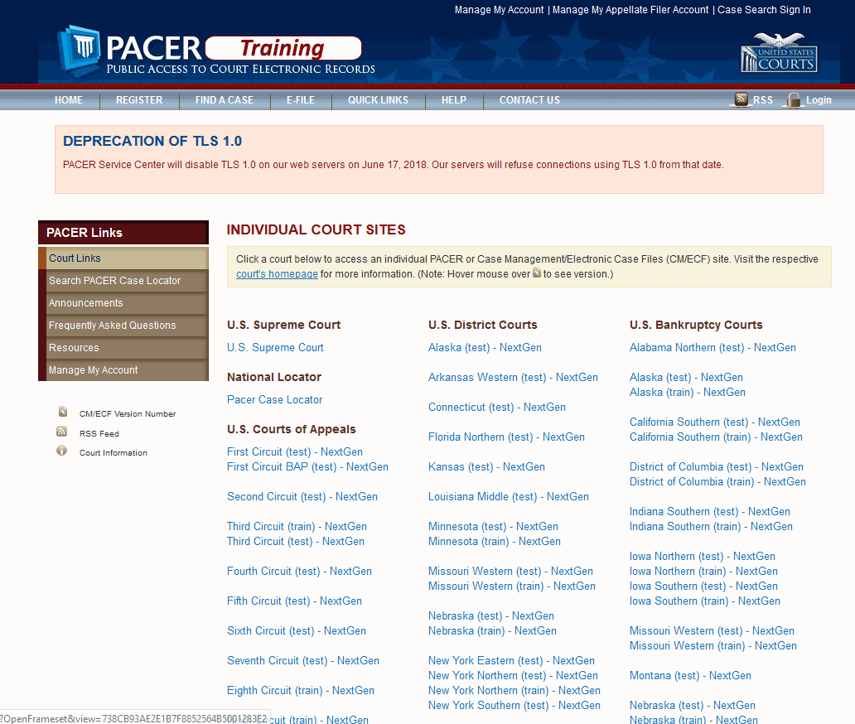
What is Central Sign-on?

Slide 6
Topic Two
Upgrading PACER accounts

Slide 7
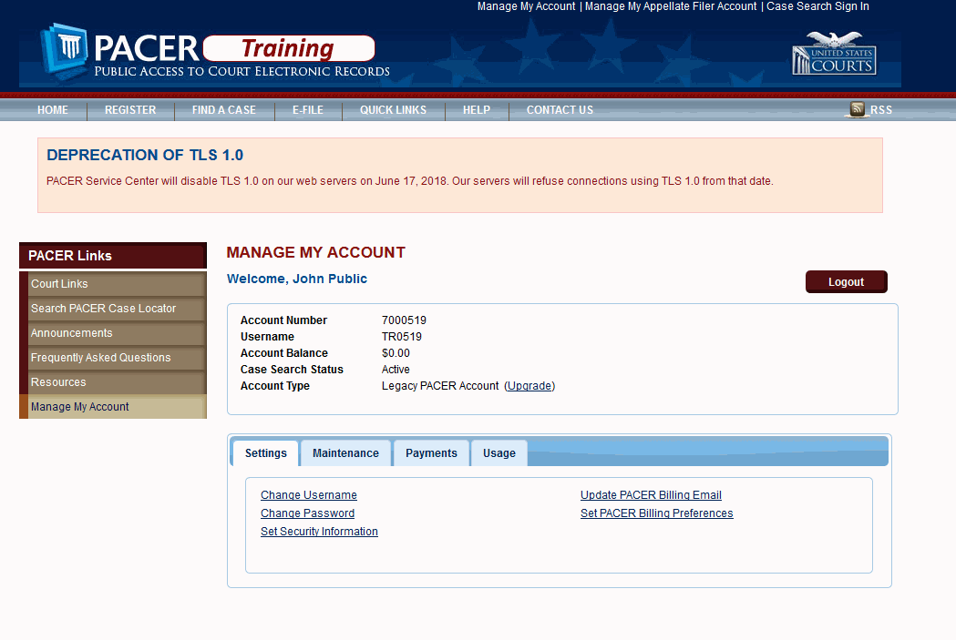
Upgrading Legacy PACER accounts
● Accounts created before August 11, 2014
● Must be individual accounts

Slide 8
Topic Three
Linking CM/ECF accounts

Slide 9
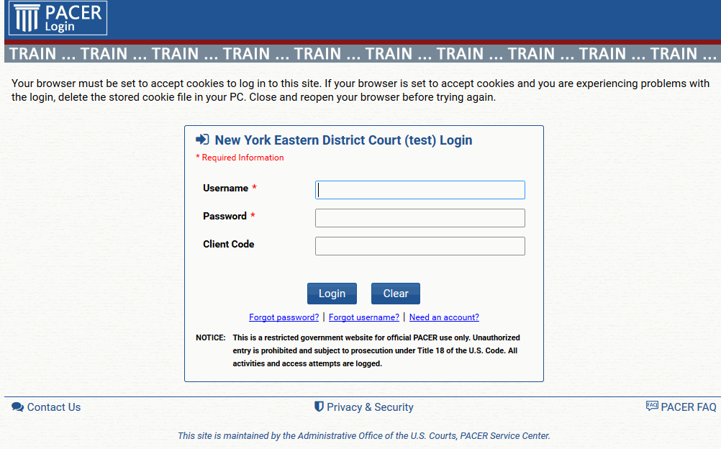
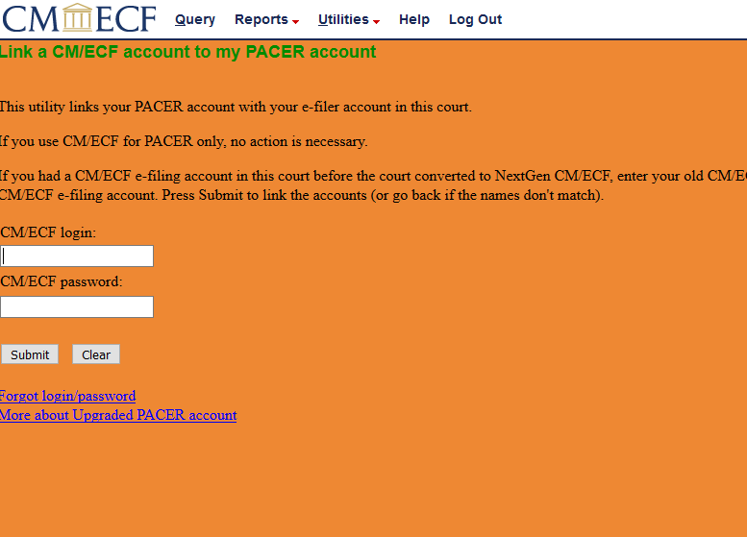
Linking CM/ECF accounts
● On or after October 9, 2018
● Must link both S.D.N.Y. and E.D.N.Y.

Slide 10
Topic Four
Attorney Admissions

Slide 11
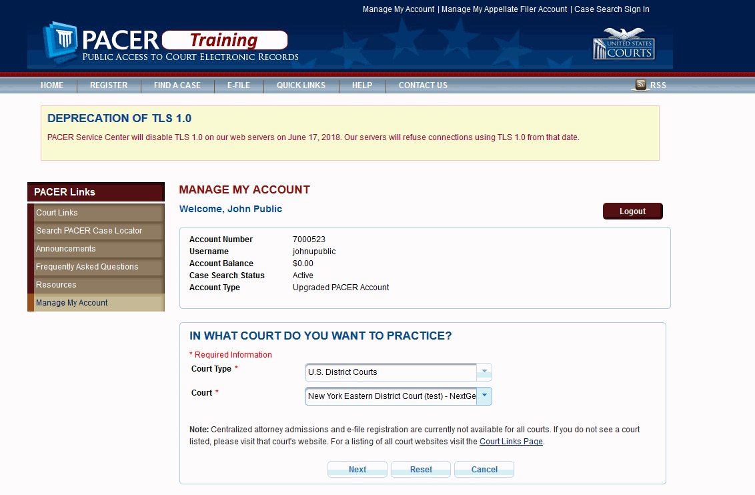
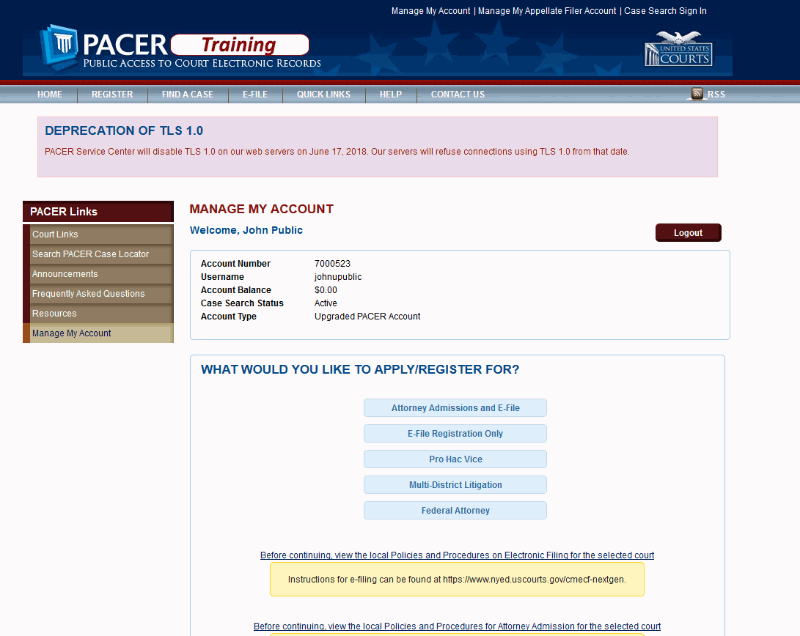
Applying for admission and e-filing
On and after October 9, 2018, applications for attorney admission and e-filing privileges will be completed through PACER.

Slide 12
Summary & What’s Ahead
What we covered today:
NextGen Go Live date is October 9th
PACER accounts created before August 2014 must be upgraded
PACER accounts must be individual accounts
CM/ECF accounts must be linked on or after October 9th
Attorney admissions will be completed through PACER on and after October 9th

